Slide 1

Shop V2.0 - An Array of Product
v2
Produced
by:
Ms. Maireád Meagher
Dr. Siobhán Drohan
Ms Siobhan Roche
Department of Computing and Mathematics
http://www.setu.ie/

Slide 2
Recap: Shop V1.0 - Product
Driver
The Product class stores details about a product
name
code
unit cost
in the current product line or not?
Product

Slide 3
Recap: Shop V1.0 - Driver
Driver
The Driver class
has the main() method.
reads the product details from the user (via the console)
creates a new Product object.
prints the product object (to the console)
Product

Slide 4
Shop V2.0
New Store class is responsible for maintaining a collection of Products
i.e. an array of Products.
Driver will now allow the user to decide how many product details they want to store.
Driver
Store
Product

Slide 5
Shop V2.0 – changes to classes
Driver
Store
Some changes
Product
This is a new
Store class
No changes

Slide 6
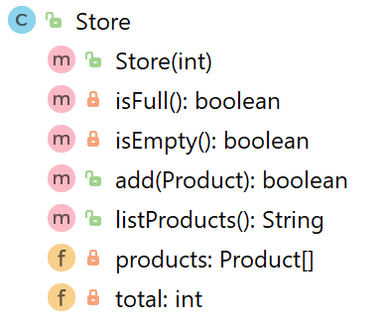
Store – new class
constructor
fields

Slide 7
Store – new class
constructor
private methods
setter
Like toString
fields

Slide 8

public class Store { private Product[] products; private int total = 0; public Store(int numberItems){ products = new Product[numberItems]; }
//other methods }
fields
Why private?
Notes:
To prevent any other class from being able to change the field values – must use getter / setter

Slide 9
public class Store { private Product[] products; private int total = 0; public Store(int numberItems){ products = new Product[numberItems]; }
//other methods }
fields
Why private?
constructor
Notes:
To prevent any other class from being able to change the field values – must use getter / setter

Slide 10
private boolean isFull(){ return (total == products.length); } private boolean isEmpty(){ return (total == 0); } public boolean add(Product product){ if (isFull()){ return false; } else{ products[total] = product; total++; return true; } }
getters
isFull() & isEmpty() return state of fields.
They are private member methods
setter
add() makes use of private method isFull()

Slide 11
public String listProducts(){ if (isEmpty()){ return "No products"; } else{ String listOfProducts = ""; for (int i = 0; i < total; i++){ listOfProducts += i + ": " + products[i] + "\n"; } return listOfProducts; } }
toString type method listProducts() makes use of private method isEmpty()
Notes:
public String toString(){
return “total: ” + total + “ \n” + this.listProducts();
}

Slide 12
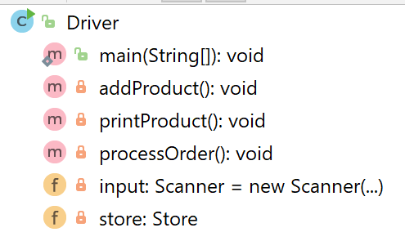
Driver
4) main() changed to call processOrder()
5 changes
2) addProduct() changed to add the entered product to the array.
5) printProduct() changed to print out all products in the array.
3) New method, processOrder(), reads in products from the user.
1) Product object removed and replaced with Store object.

Slide 13
Driver
Change - 1
import java.util.Scanner; public class Driver{ private Scanner input = new Scanner(System.in); private Store store;
//code omitted
}
1) Product object removed and replaced with Store object.

Slide 14
2) New method, processOrder(), reads in products from the user.
Driver
Change - 2
private void processOrder(){ //find out from the user how many products they would like to order System.out.print("How many Products would you like to have in your Store? "); int numberProducts = input.nextInt(); store = new Store(numberProducts); //ask the user for the details of the products and add them to the order for (int i = 0; i < numberProducts; i++){ addProduct(); } }
Asks how many?
Pass into Store constructor to initialise an array to that size
Calls addProduct() for each one

Slide 15
Driver
3) main() changed to call processOrder()
Change - 3
public static void main(String[] args) { Driver driver = new Driver(); driver.processOrder(); driver.printProduct(); }

Slide 16
Store
If there is space in the Array, the Product, passed as a parameter is added to the Primitive Array.
A boolean result is returned indicating whether the product was added successfully or not.
public boolean add(Product product){ if (isFull()){ return false; } else{ products[total] = product; total++; return true; } }

Slide 17
4) addProduct() changed to add the entered product to the array.
Driver
Change - 4
Driver
The addProduct() method needs to be updated to:
Add the product object to the array of products in Store
Interrogate the Boolean result returned to let the user know if the update was successful or not.

Slide 18
private void addProduct(){ input.nextLine(); //dummy read of String to clear the buffer - bug in Scanner class. System.out.print("Enter the Product Name: "); String productName = input.nextLine(); System.out.print("Enter the Product Code: "); int productCode = input.nextInt(); System.out.print("Enter the Unit Cost: "); double unitCost = input.nextDouble(); //Ask the user to type in either a Y or an N then convert to boolean value System.out.print("Is this product in your current line (y/n): "); char currentProduct = input.next().charAt(0); boolean inCurrentProductLine = false; if ((currentProduct == 'y') || (currentProduct == 'Y')) inCurrentProductLine = true; boolean isAdded = store.add(new Product(productName, productCode, unitCost, inCurrentProductLine)); if (isAdded){ System.out.println("Product Added Successfully"); } else{ System.out.println("No Product Added"); } }

Slide 19
private void addProduct(){ input.nextLine(); //dummy read of String to clear the buffer - bug in Scanner class. System.out.print("Enter the Product Name: "); String productName = input.nextLine(); System.out.print("Enter the Product Code: "); int productCode = input.nextInt(); System.out.print("Enter the Unit Cost: "); double unitCost = input.nextDouble(); //Ask the user to type in either a Y or an N then convert to boolean value System.out.print("Is this product in your current line (y/n): "); char currentProduct = input.next().charAt(0); boolean inCurrentProductLine = false; if ((currentProduct == 'y') || (currentProduct == 'Y')) inCurrentProductLine = true; boolean isAdded = store.add(new Product(productName, productCode, unitCost, inCurrentProductLine)); if (isAdded){ System.out.println("Product Added Successfully"); } else{ System.out.println("No Product Added"); } }
Read in a string
Read in an int
Read in an double
Read in an char
Set boolean based on char value

Slide 20
private void addProduct(){ input.nextLine(); //dummy read of String to clear the buffer - bug in Scanner class. System.out.print("Enter the Product Name: "); String productName = input.nextLine(); System.out.print("Enter the Product Code: "); int productCode = input.nextInt(); System.out.print("Enter the Unit Cost: "); double unitCost = input.nextDouble(); //Ask the user to type in either a Y or an N then convert to boolean value System.out.print("Is this product in your current line (y/n): "); char currentProduct = input.next().charAt(0); boolean inCurrentProductLine = false; if ((currentProduct == 'y') || (currentProduct == 'Y')) inCurrentProductLine = true; boolean isAdded = store.add(new Product(productName, productCode, unitCost, inCurrentProductLine)); if (isAdded){ System.out.println("Product Added Successfully"); } else{ System.out.println("No Product Added"); } }
The Store add method is called to add the product to the primitive array, if space is available.
Console response if add was successful
Console response if add was unsuccessful

Slide 21
Driver
Change - 5
5) printProduct() changed to print out all products in the array.
private void printProduct(){
System.out.println(store.listProducts());
}

Slide 22
Summary Shop V2.0
Driver
Some(5) changes
Store
Product
This is a new
Store class
No changes
Store class maintains a collection of Products i.e. an array of Products; store.Products[]
Driver allows the user to decide how many product details they want to store. Methods updated to work with this new store.Products[] array

Slide 23

Questions?

